Slide 1
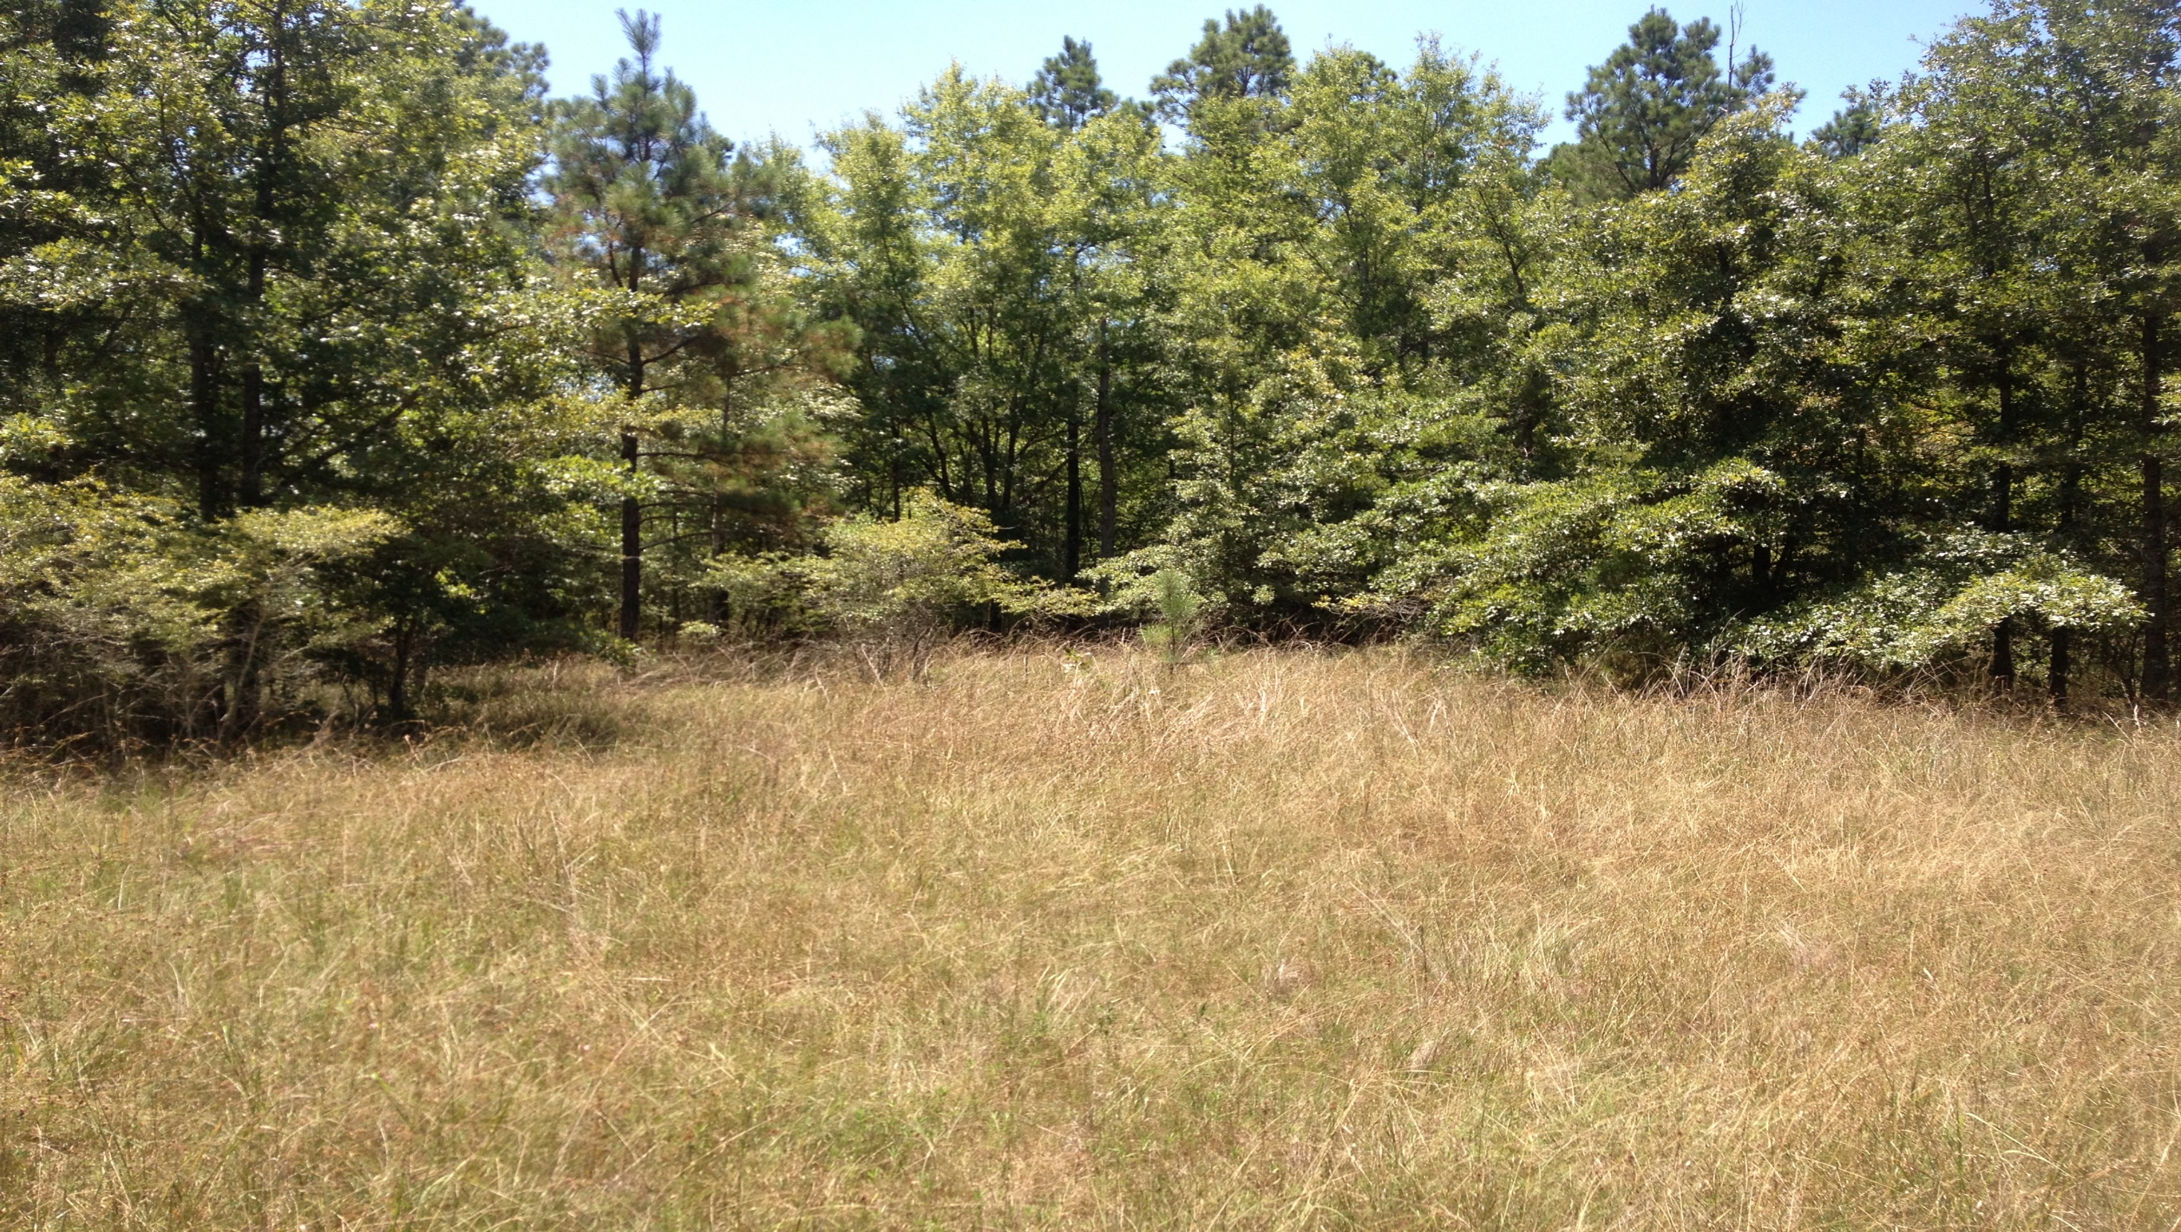
Chris Doffit
Field Botanist/Natural Areas Registry Coordinator
Louisiana Natural Heritage Program

Slide 2
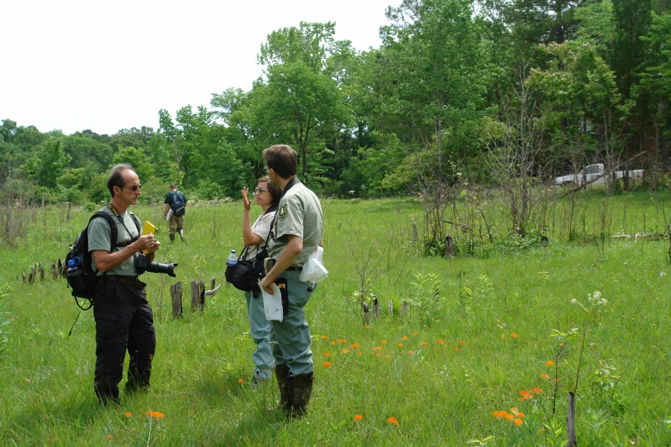
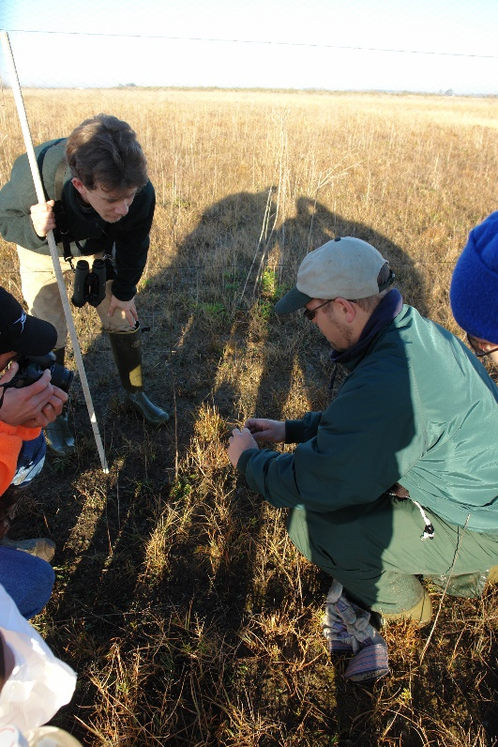
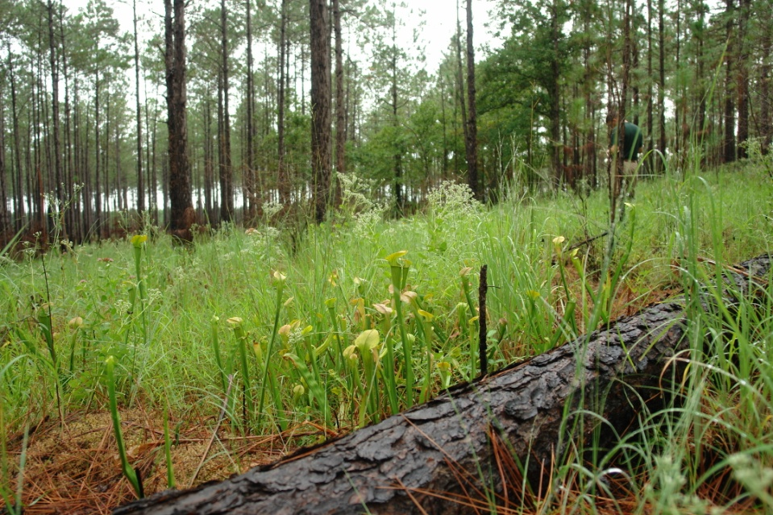
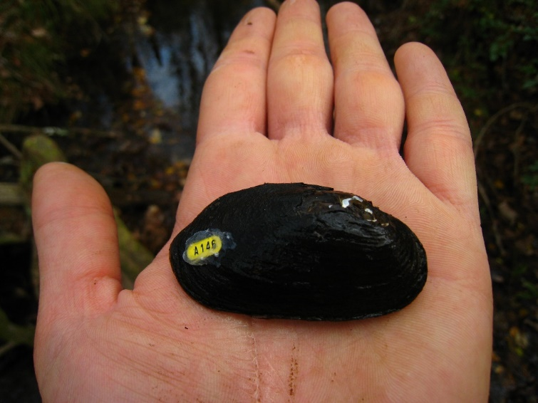
Natural Heritage Program Mission
To gather, process, and provide information on rare, threatened and endangered plants and animals, and ecologically significant natural communities of Louisiana to enhance their conservation.

Slide 3
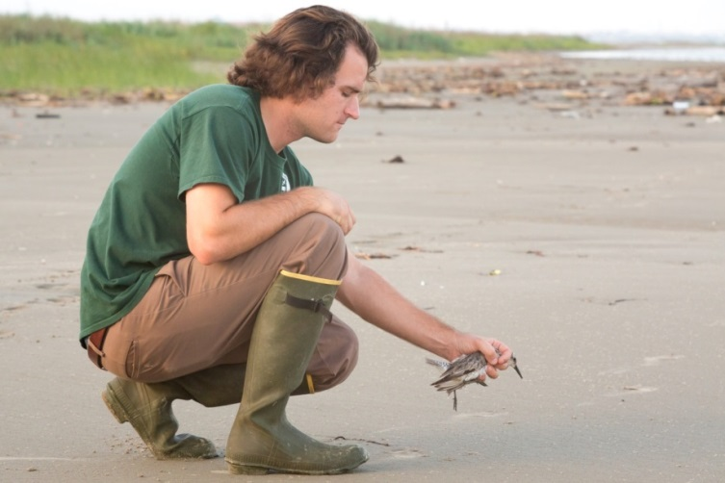
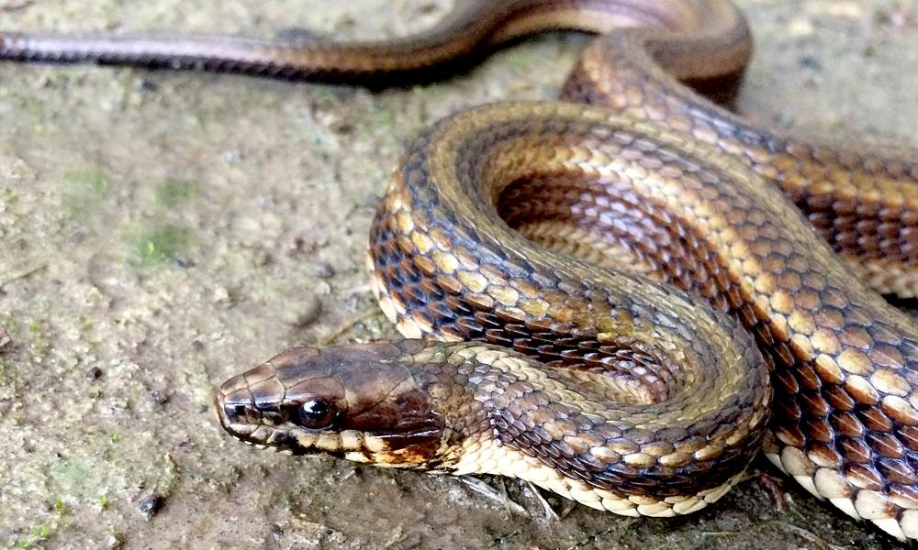
LNHP
  Administer the provisions of law and rules and regulations regarding Threatened and Endangered Animal Species
Maintain database on rare species and habitats
Provide technical assistance and management plans for habitats and non-game species (public and private)
Implement habitat stewardship on private and public lands
Conduct research on priority habitats and species
  Administer the Natural Areas Registry
Coordinate State Wildlife Grants program and Wildlife Action Plan revisions
LNHP staff releasing a red knot on Elmer’s Island
Gulf Coast saltmarsh snake, Grand Isle

Slide 4
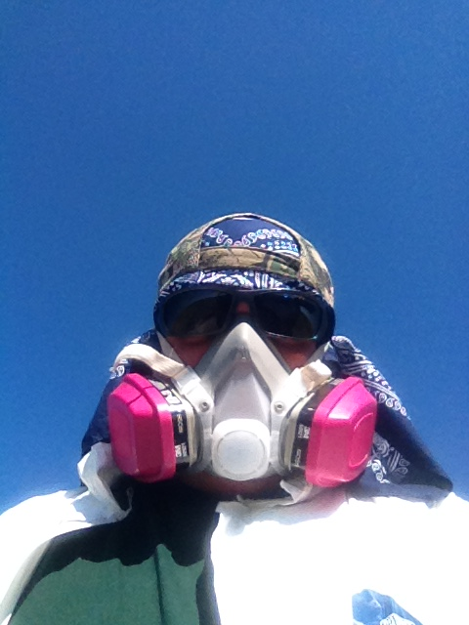
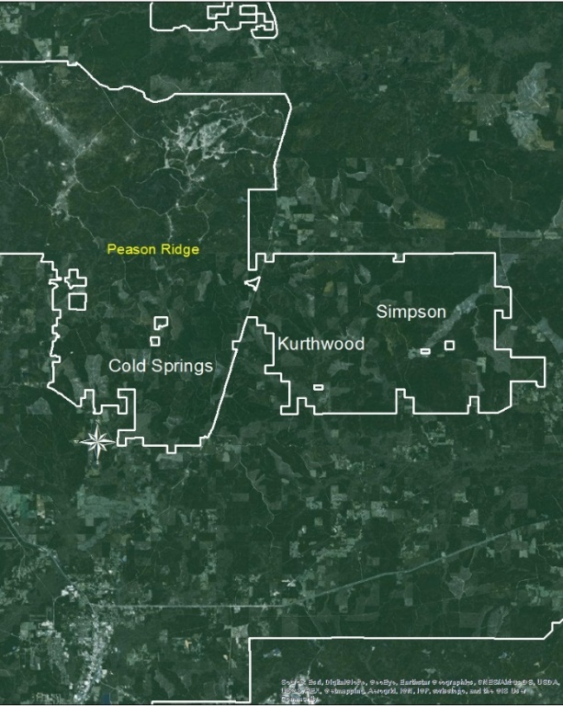
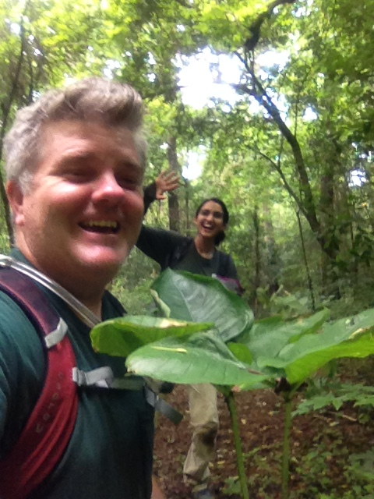
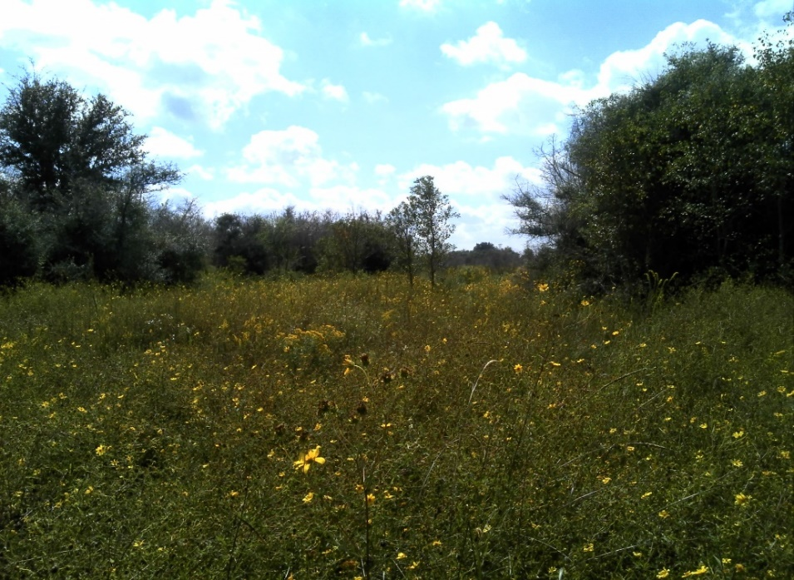
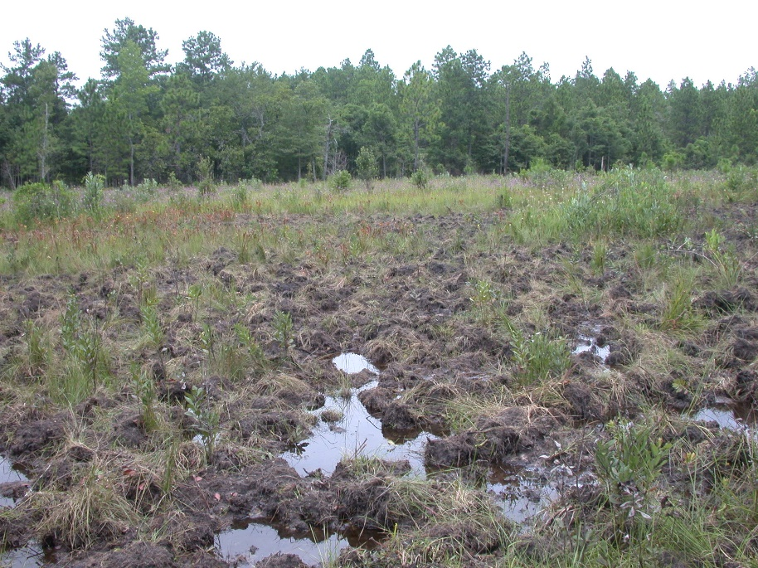
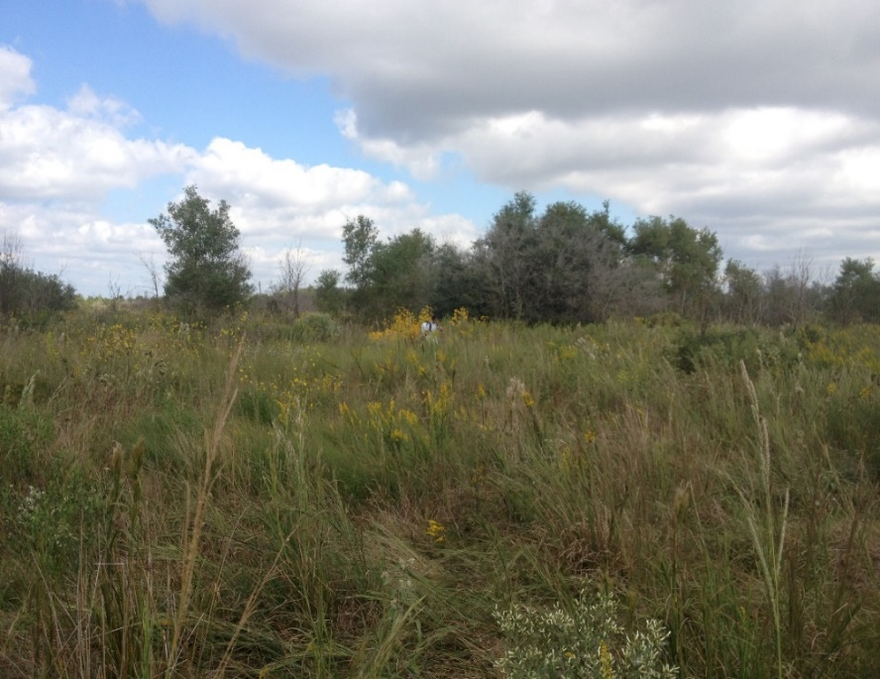

Slide 5
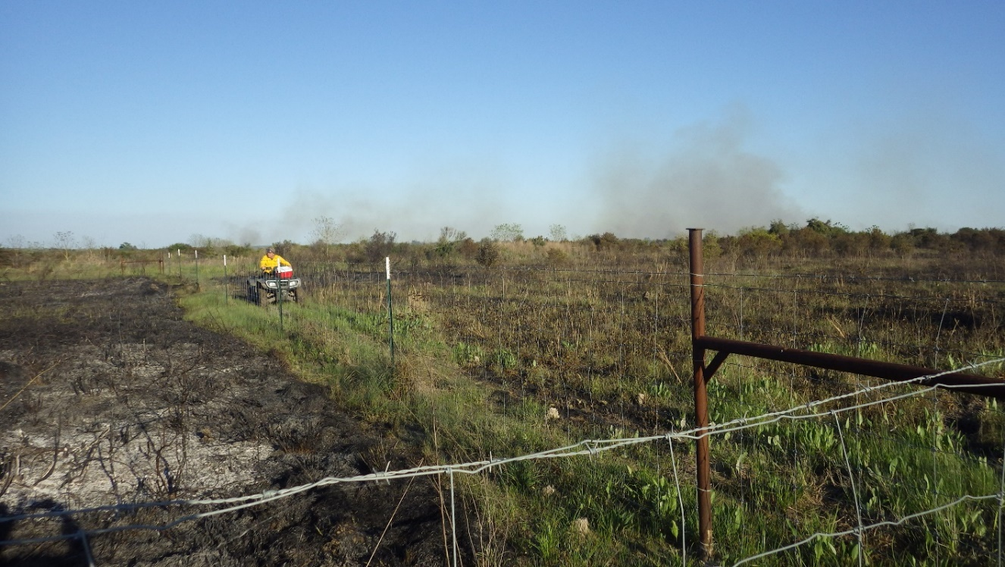
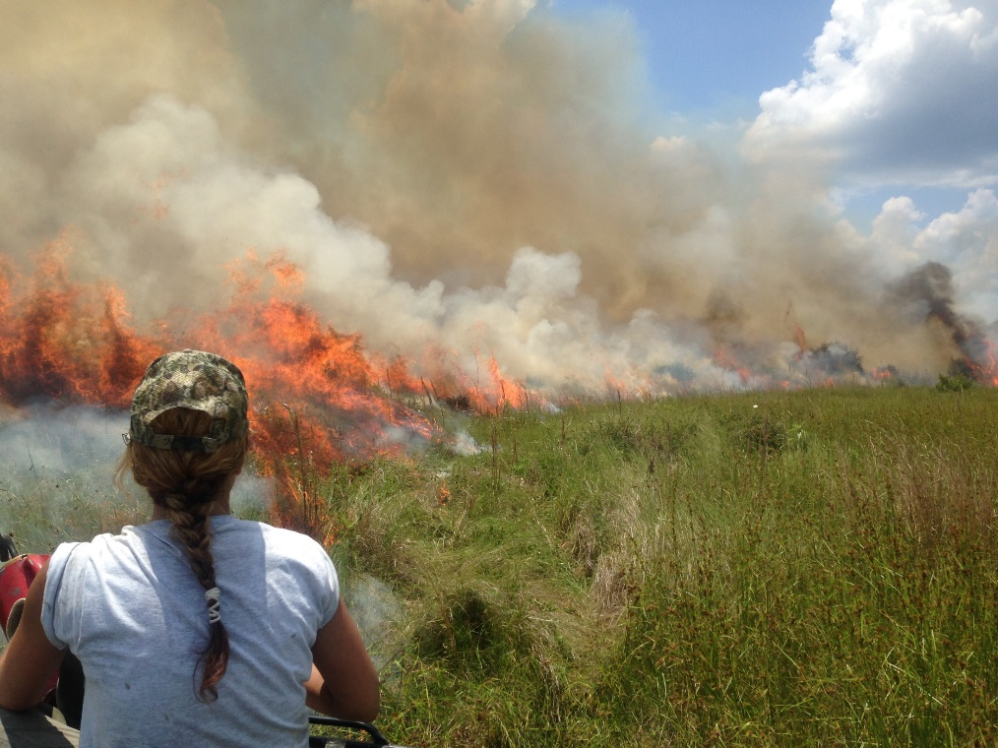
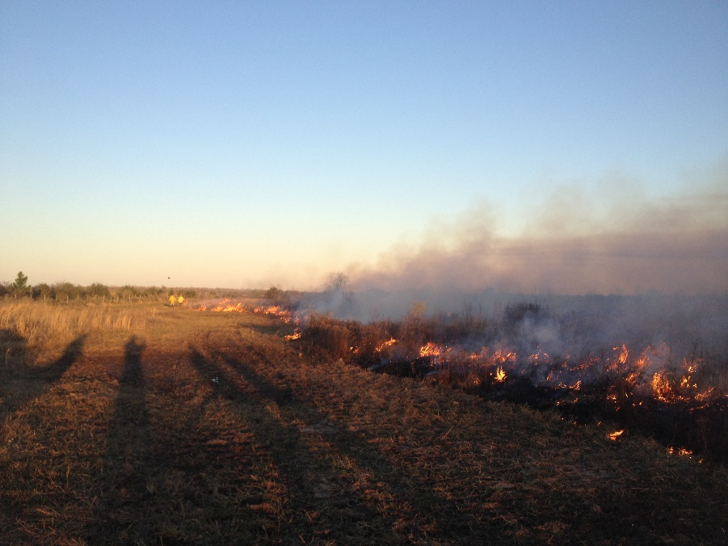
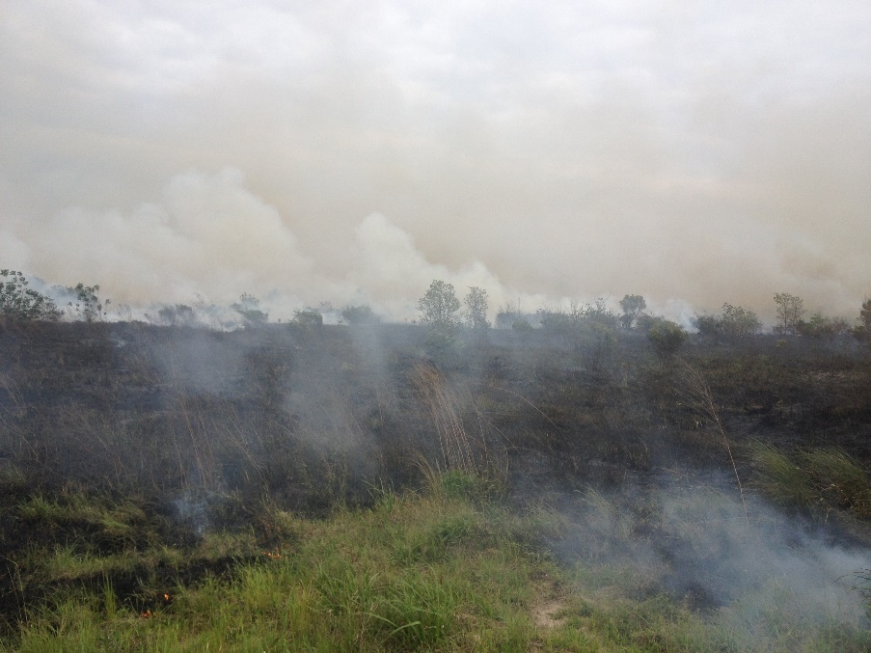
LDWF has burned

Slide 6
LNHP Prairie Burning Since 2014
Figures in red font denote growing season burns
Site/Unit | Acreage Burned by Year
 | 2014 | 2015 | 2016 | 2017 | 2018
Coulee Jack East | 210
Coulee Jack West | 250 |  | 250
Cox North | 150 | 150
Cox South | 150 |  | 150
Gray East |  | 90 | 90 | 90 | 90
Gray “Lamb Chop” |  | 54 |  | 54
Gray Marsh Fringe |  | 465 |  | 465 | 465
Gray West |  |  | 469* | 469 | 469
Gum Cove |  | 110 |  | 110
TOTAL ACREAGE | 760 | 869 | 959 | 1,188 | 1,024
* wildfire

Slide 7
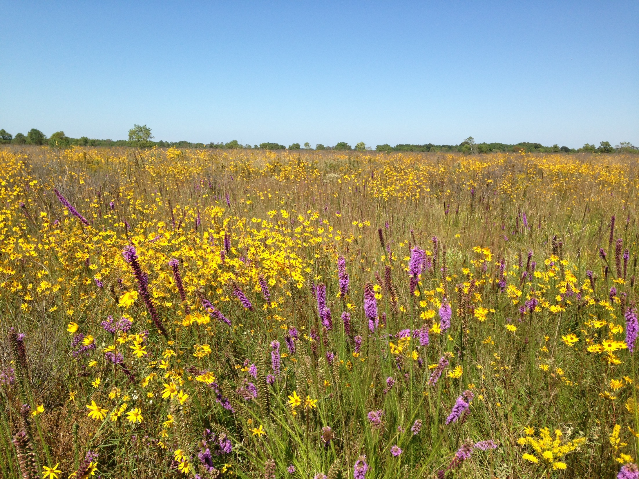
Coastal Prairie in Calcasieu Parish
Photo taken in October, site burned in May

Slide 8
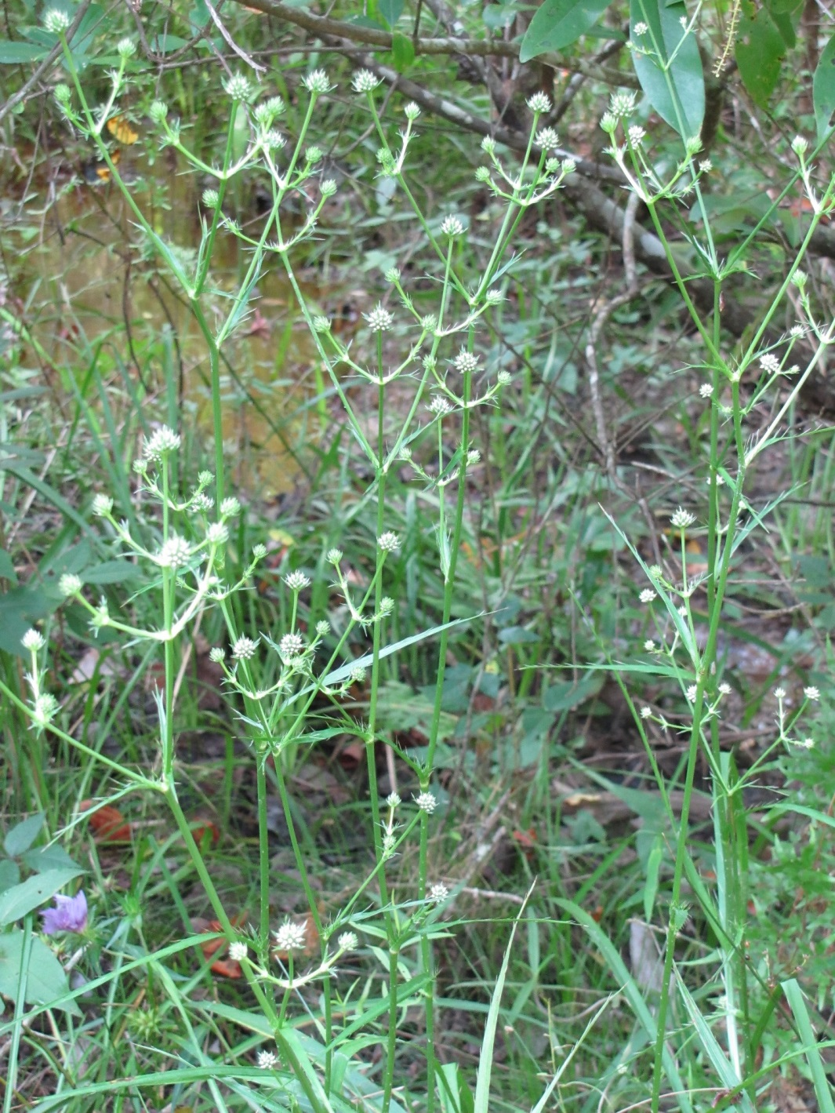
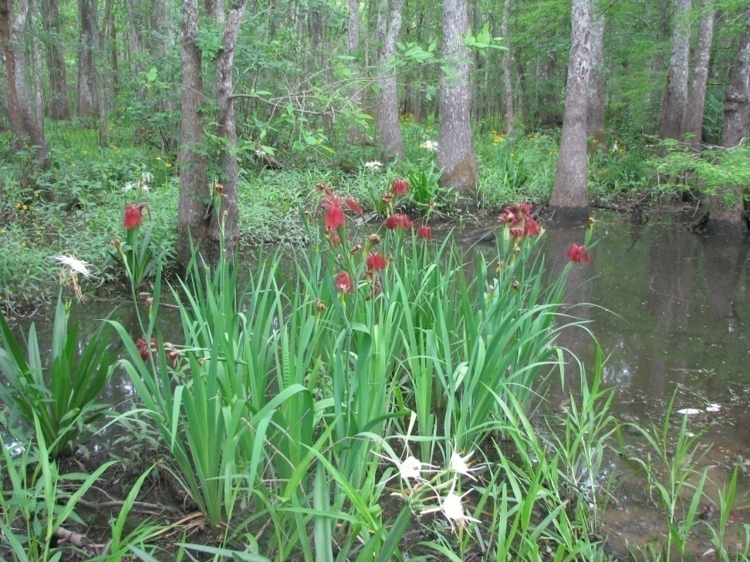
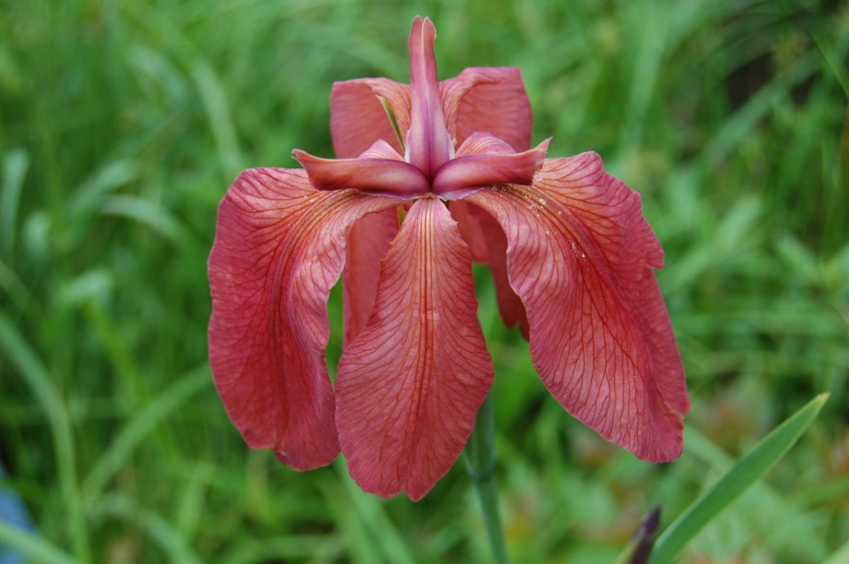
Plants Endemic to Louisiana
Abbeville red iris - Iris nelsonii
moccasin master – Eryngium sp. nov.

Slide 9
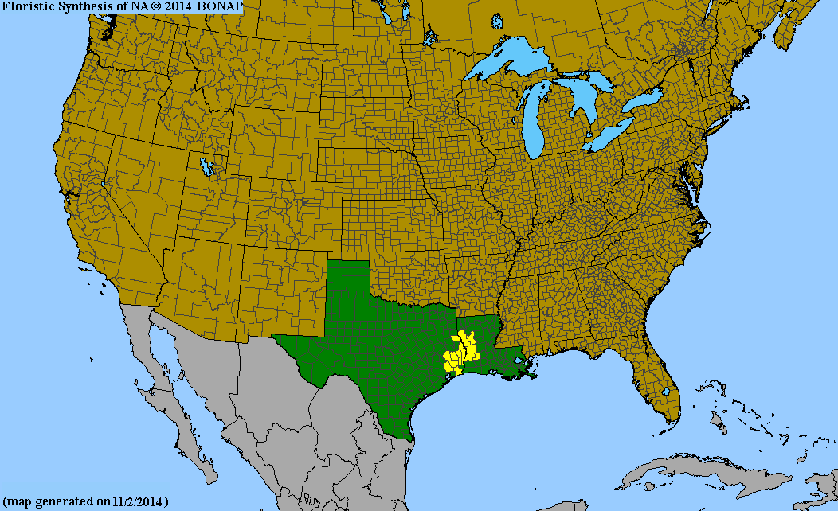
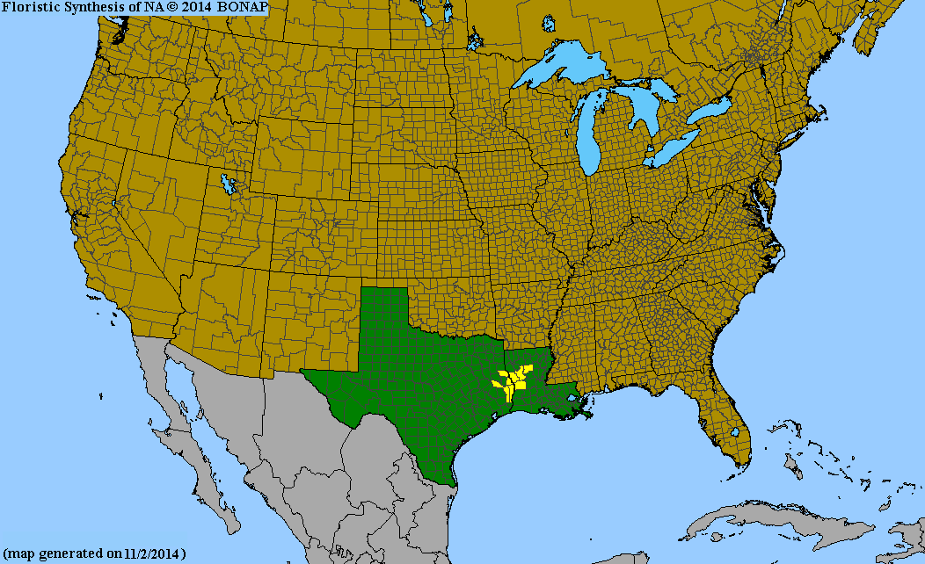
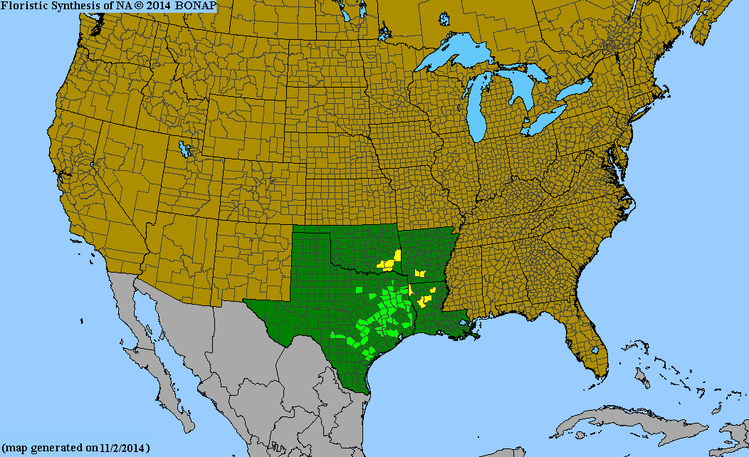
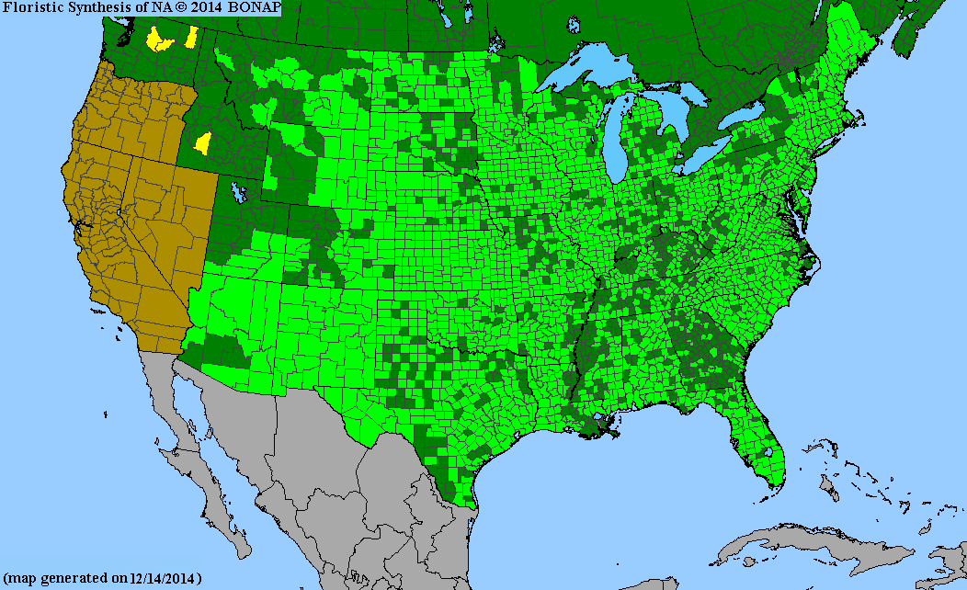
Examples of Narrow/Regional Endemics
Narrow endemic
Narrow endemic
Scarlet catchfly – Silene subciliata
Sabine coneflower – Rudbeckia scabrifolia
WGCP endemic
Widespread species
Cupleaf penstemon – Penstemon murrayanus
Little bluestem – Schizachyrium scoparium

Slide 10
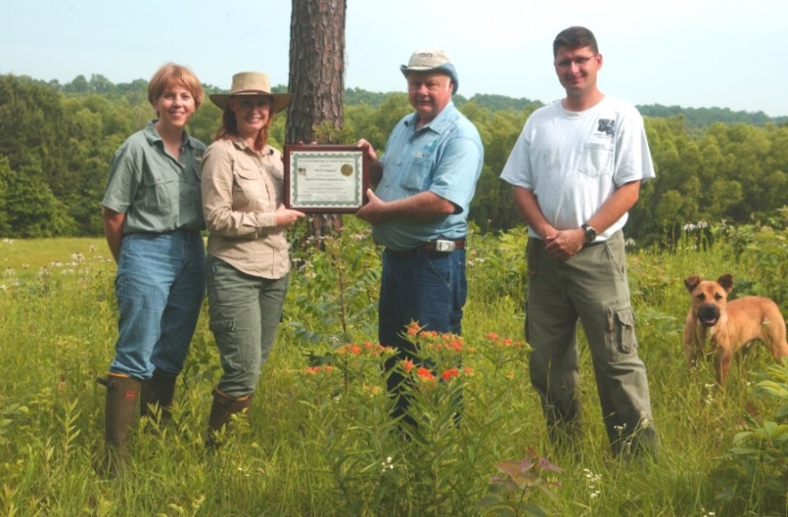
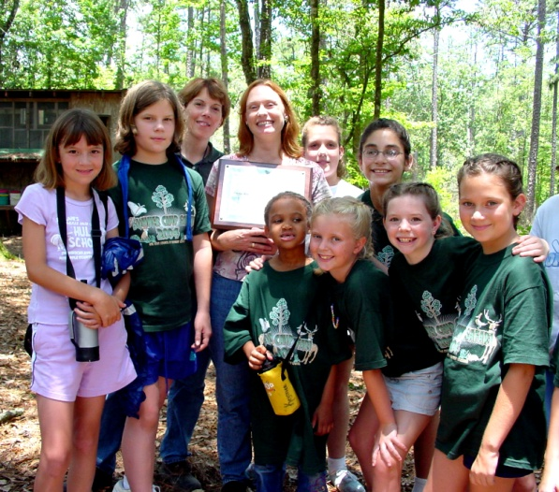
Natural Areas Registry
Voluntary conservation partnership between a landowner and LDWF
(legally non-binding)
Potential Natural Area - support a rare species or habitat, or high-quality example of a non-rare habitat
Created by Louisiana
Legislature in 1987
Title 56, Ch. 8 (Natural
Heritage Preservation),
Part III
Rector’s Prairie Natural Area
Camp Whispering Pines Natural Area
Notes:
Saline Prairies have wet and dry phases with dense clay pan
High level exchangeable sodium
Mostly treeless
Interspersed slicks and scattered pimple mounds
Flora is drought tolerant

Slide 11
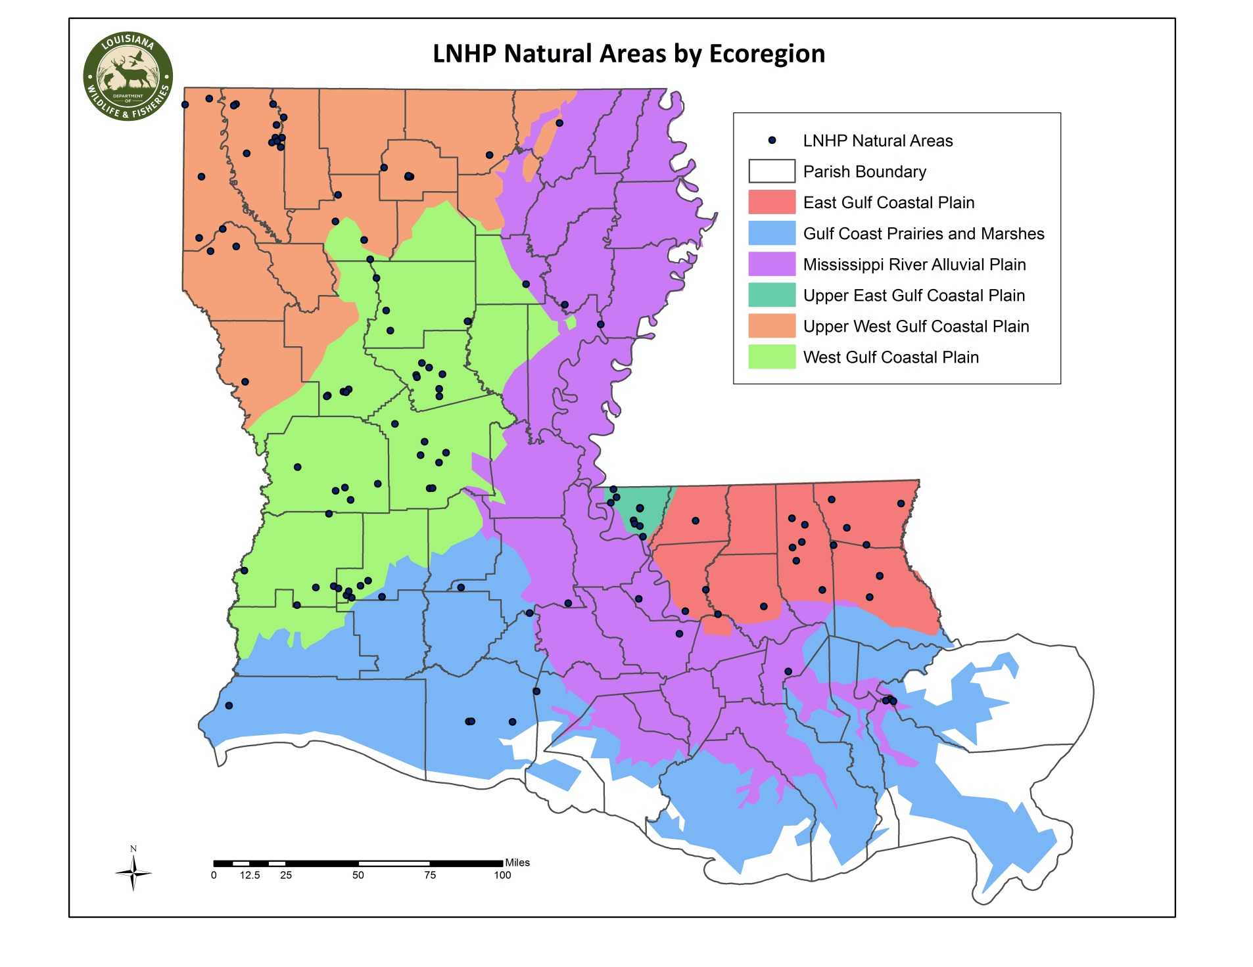
121 Natural Areas (48,719 acres)

Slide 12
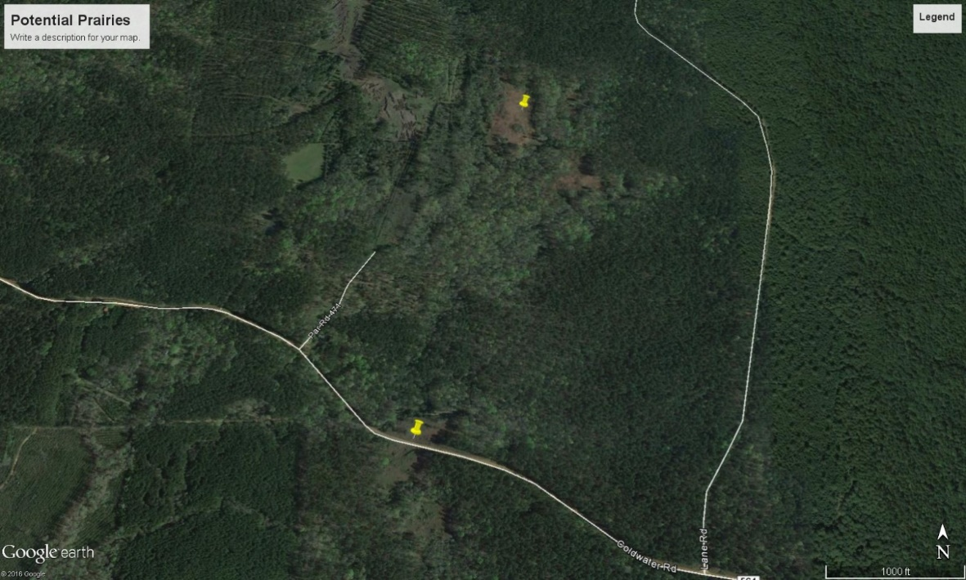
The Process of Protecting Natural Areas
Contacted by directly by landowners
Talk to landowners about special plants, animals or natural communities which occur on their property.
Identify areas based on aerial photography and contact landowners
Look up historical collections of rare or interesting plants.

Slide 13
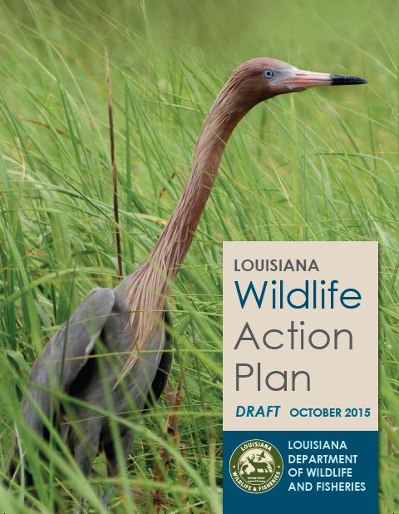
Wildlife Action Plan
State Wildlife Grants – started in 2001; funding provided by USFWS for research and stewardship
Purpose is to provide a roadmap for addressing declining wildlife
Each state has developed a Plan – 1st edition completed in 2005
WAP is updated every 10 years
Final draft of 2015 revision is available at www.wlf.louisiana.gov/wildlife/wildlife-action-plan
Notes:
Purpose is to develop a blue print for guiding LDWF
development and management actions
LA species of conservation concern and their habitats
Areas of Focus will be on
species of conservation concern and their habitats
threats
management actions
public outreach and education
research needs
Lake Ramsey Preserve adjacent Lake Ramsey WMA
Longleaf Pine Savannah in St Tammany Parish
Parrot pitcher plant flowers in southeastern hillside seepage bogs and wet longleaf pine savannahs

Slide 14
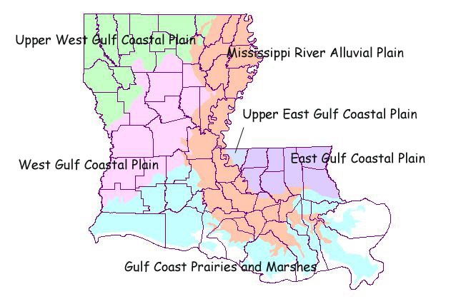
Louisiana Ecoregions

Slide 15
Habitat Conservation
Habitat types classified Identified in State Wildlife Action Plan
Broad Categories include:
  Forests
  Savannas & Woodlands
  Shrublands
  Grasslands
  Ephemeral Ponds
  Lentic Water bodies
  Submerged Aquatic Vegetation
  Subterranean Habitat
  Geologic Feature
  Anthropogenic Habitats
  River Basins
  Marine Habitats
Each Category is broken down into several sub-categories

Slide 16
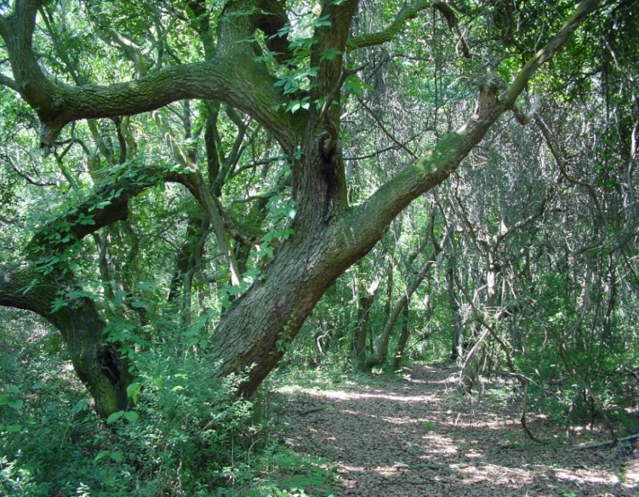
Forest- Barrier Island Live Oak Forest
Current Extent
Rarity Ranks: S1/G1Q
Synonyms: Maritime Forest
Barrier Island Live Oak Forest Grand Isle, Jefferson Davis Parish

Slide 18
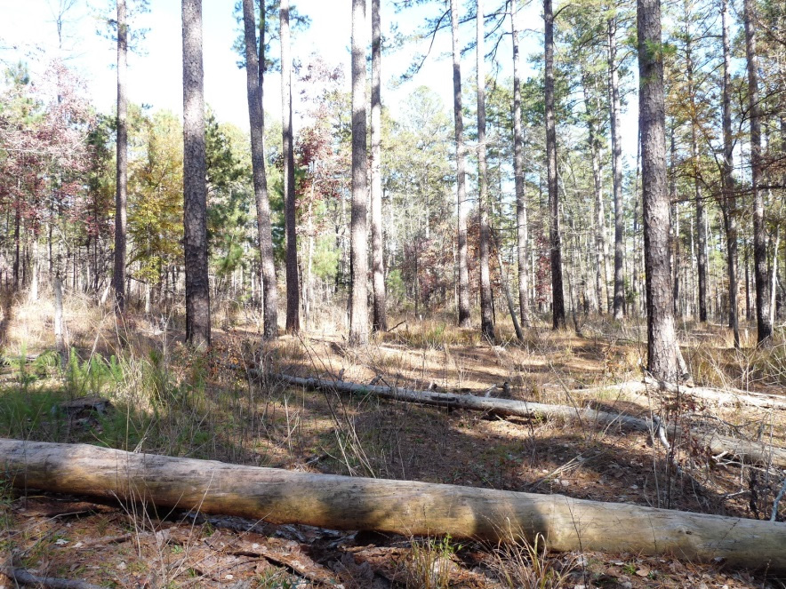
Savannas & Woodlands – Shortleaf Pine/Oak-Hickory Woodland
Rarity Rank: S1/G2G3
Synonyms: Shortleaf Pine-Oak, Oak-Hickory Forest
Shortleaf Pine/Oak-Hickory Woodland, Lincoln Parish

Slide 19
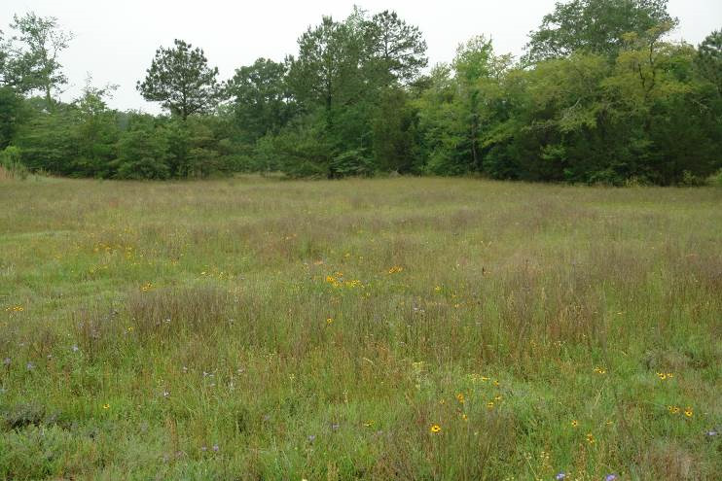
Grassland – Coastal Prairie
Upland Saline Prairie, De Soto Parish, LA
Rarity Rank: S1S2/G1G2
Synonyms: Alkali Flats, Barrens, Salt Barrens, Slicks

Slide 20
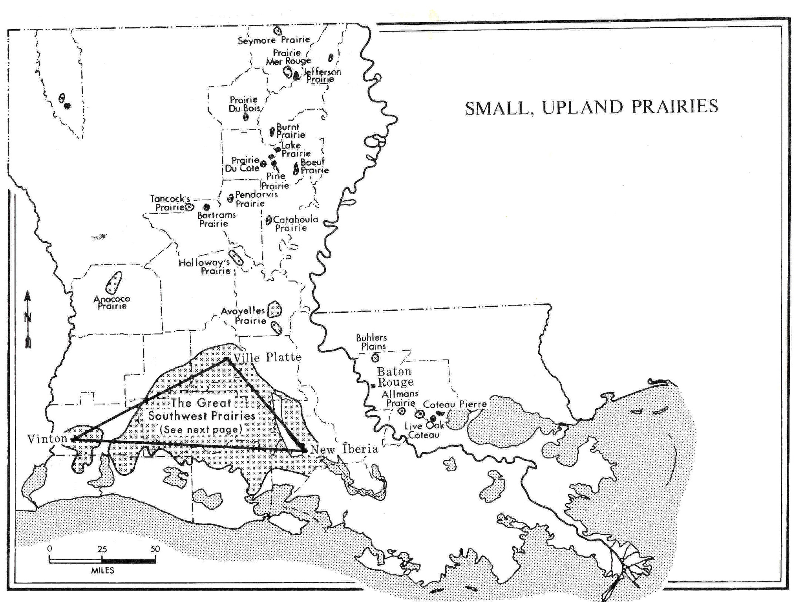

Slide 21
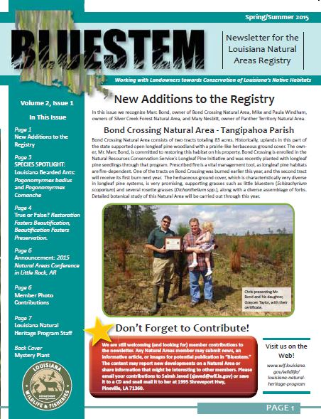
Benefits of Enrolling in the Natural Areas Registry
Gain biodiversity information
Management guidance and planning
Signs for posting
Yearly or as-needed ecological check-ups
Addition of LDWF as an advocate for
Natural Area protection
Semi-annual newsletter
(Habitat management assistance -
e.g. prescribed fire, invasive species
removal)

Slide 22

Questions
?
?
Chris Doffitt
Field Botanist/Natural Areas Registry Coordinator
1995 Shreveport Hwy.
Pineville, LA 71360
318-487-5885 Ext.3424
cdoffitt@wlf.la.gov

